Slide 1
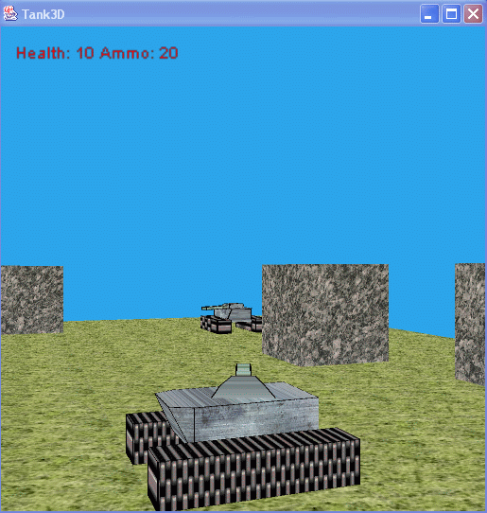
dTank: A neutral environment for teaching and testing agent architectures
Geoffrey P. Morgan¹, Frank E. Ritter¹,
Ian N. Schenck¹, Mark A. Cohen^{1,2}
1 School of IST, Penn State
2 BA CS & IT Department, Lock Haven University
The development of this software was supported by ONR (contract N000140210021). It was also supported by the Director of Technology Development, Ministry of Defence, Metropole Building, Northumberland Ave, London WC2N 5BP and was carried out under the terms of Contract No RT/COM/2/007. The use of CaDaDis and Vista was supported by the Office of Naval Research through a subcontract from Soar Technology, contract VISTA03-1. We also thank Isaac Councill for his work on SoarTank and work on dTank.
The views expressed in this article do not necessarily reflect the positions or the policies of the U.S. Government, and no official endorsement should be inferred.

Slide 2
Introduction
dTank is an environment for the comparison of humans, agents, and models
Inspired by As-sanie and Laird’s Tank-Soar environment
Light-Weight alternative to ModSAF, JSAF, OTB, etc.
Simple enough to be used by students
Complex enough to create interesting behavior

Slide 3
Overview of Presentation
dTank’s Design, why agents and humans can be easily compared
Architectures supported by dTank
Data Logging in dTank
Summary and Future of dTank

Slide 4
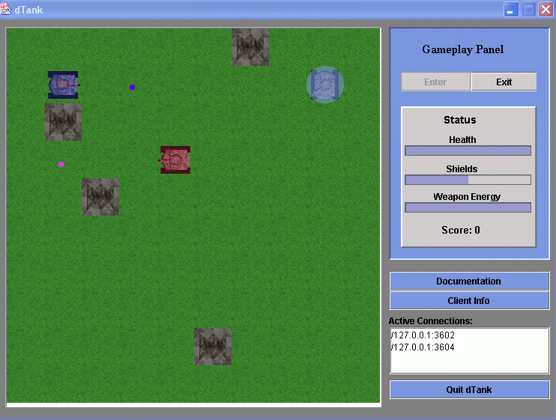
Features of dTank’s Design
Client-Server Architecture
Java
Socket Communications
Sensory Filtering
Logging
Easy to Edit Maps
Variable Board Size

Slide 5
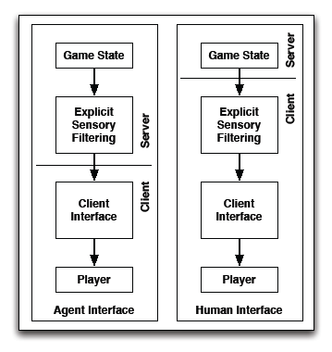
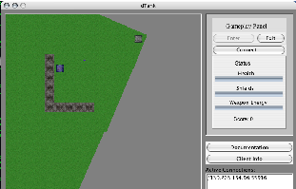
Sensory Filtering

Slide 6
Architectures supported by dTank
Java
Jess
Soar
Herbal
CAST
ACT-R
Jack

Slide 7
Development Times for some actors
Java
  Five Man-Hours
  Took advantage of java objects designed to support dTank agents
Jess
  One Man-Hour
  Does not assume automatic handling of implicit trigonometric equations
Soar
  Three Man-Hours, by the original dTank developer

Slide 8
Data Logging in dTank
Logging allows painless capture of human and agent data
Conversion software transforms dTank native logs, which include input and output, into CaDaDis logs ( Tor, Ritter, Haynes & Cohen, 2004)
Software also summarizes actions taken for easy overall analysis
CaDaDis builds on Vista ( Taylor, Jones, Goldstein & Frederiksen, 2002) and creates graphical sequence logs.
This has been used to compare a novice and several different agents built in different architectures for strategy similarity ( Morgan, Ritter, Schenck, Stevenson, & Cohen, 2005)

Slide 9
Overview of Attempted Actions of All Actors, a sample
Five Minute period for all agents and players
Actor | Fire | Rotate | Move | Turn-CC¹ | Turn-C²
Participant | 350 | 569 | 529 | 42 | 8
JavaTank | 693 | 193 | 310 | 35 | 38
JessTank | 39 | 91 | 202 | 100 | 62
SoarTank | 316 | 90 | 93 | 62 | 69
¹ Turn Counter-Clockwise
² Turn Clockwise

Slide 10
Win/Lose Ratio in 1 on 1 Duels with a non-logging JavaTank Agent
Actor | Win | Lose
Participant | 17 | 15
Java (Logging) | 4 | 8
Jess | 0 | 10
Soar | 4 | 8

Slide 11
Architectural Comparisons in dTank
Proved useful so far.
CAST and Soar teamwork behavior compared ( Sun, Fan, Ritter & Yen, 2004)
More planned in the future between:
  Error-Soar
  ACT-R
  Jack
  COJACK

Slide 12
Gold Nuggets
A useful teaching environment (3 universities, 100+ Undergraduates) ( Cohen, 2005;  Morgan, Ritter, Haynes & Cohen, 2005)
Useful architectural comparisons
Broad range of behaviors possible, not limited to adversarial relationships between agents.

Slide 13
Lumps of Coal
dTank’s Soar interface not compatible with 8.6
Resource-heavy for a Java GUI program
Current implementation difficult to scale up for more vehicle and terrain types, etc. (but revision in process)

Slide 14
dTank’s Future
Architectural refactoring to support increasing complexity
v8.6 Compliance
More platforms w/ more example models
Round-Robin battle formats
Comparison of agents in Jack and COJACK

Slide 15
References
Cohen, M. A. (2005). Teaching agent programming using custom environments and Jess. AISB Quarterly, 120(Spring), 4.
Councill, I.G., G.P. Morgan, and F.E. Ritter. (2004). dTank: A competitive environment for distributed agents: Applied Cognitive Science Lab, School of Information Sciences and Technology, Penn State.
Morgan, G. P., Haynes, S., Ritter, F. E., & Cohen, M. (2005). Increasing efficiency of the development of user models. In Proceedings of the 2005 Systems and Information Engineering Design Symposium. E. J. Bass, (ed). IEEE and Department of Systems and Information Engineering, University of Virginia: Charlottesville, VA.
Morgan, G. P., Ritter, F. E., Stevenson, W. E., Schenck, I. N., & Cohen, M. A. (2005). dTank: An environment for architectural comparisons of competitive agents. In L. Allender & T. Kelley (Eds.), Proceedings of the 14th Conference on Behavior Representation in Modeling and Simulation. 133-140. 05-BRIMS-043. Orlando, FL: U. of Central Florida.
Taylor, G., Jones, R. M., Goldstein, M., & Frederiksen, R. (2002). VISTA: A generic toolkit for visualizing agent behavior. In Proceedings of the 11th Computer Generated Forces Conference. 29-40, 02-CGF-044. Orlando, FL: U. of Central Florida.
Tor, K., Haynes, S. R., Ritter, F. E., Cohen, M. A. (2004). Categorical data displays generated from three cognitive architectures illustrate their behavior. In Proceedings of the International Conference on Cognitive Modeling. 302-307. Mahwah, NJ: Lawrence Erlbaum.
Sun, S., Councill, I., Fan, X., Ritter, F. E., & Yen, J. (2004). Comparing teamwork modeling in an empirical approach. In Proceedings of the Sixth International Conference on Cognitive Modeling. 388-389. Mahwah, NJ: Lawrence Erlbaum.

